Slide 1

Digital Camp Directors Meeting
2023
This Photo by Unknown Author is licensed under CC BY-NC-ND

Slide 2

Ulster County Department of Health
Carol M. Smith, M.D., M.P.H- Commissioner of Health
845-340-3150
Tim Rose P.E., BCEE, QEP, M.P.A. - Director of Environmental Services
845-340-3031
Laura Bell- Environmental Health Manager
lbel@co.ulster.ny.us
845-340-3028
Jeffrey Dekoskie- Public Health Sanitarian
jdok@co.ulster.ny.us
845-340-3033
Brianna Hafner- Public Health Technician
bhaf@co.ulster.ny.us
845-340-3019
Water*
Paige Sheeley- Public Health Sanitarian
pshe@co.ulster.ny.us
845-443-8819
Water op. report and sample submission email address- DOHNCS@co.ulster.ny.us
Main- 845-340-3010
After Hours- 845-943-6104
Fax- 845-340-3045

Slide 3
https://ulstercountyny.gov/health/childrens-camps
Please refer often to the Ulster County Department of Health Camp webpage often for emergency updates, guidance and links to application paperwork.

Slide 4
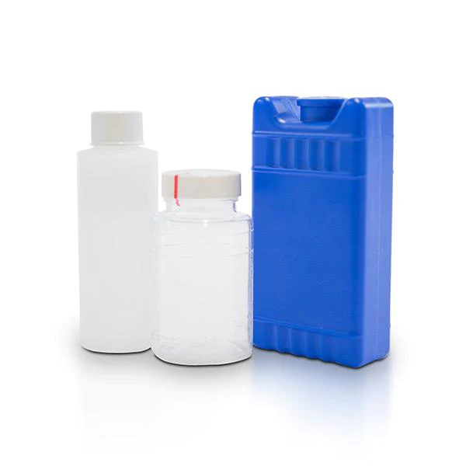
*Water New*
Sampling:
Every year, more and more camps forget to collect a nitrate sample during the operating season.
To help avoid this from happening, we will now require that nitrate sample results are submitted prior to the permit being issued.
Consuming too much nitrate can affect how blood carries oxygen and can cause methemoglobinemia (also known as blue baby syndrome).

Slide 5
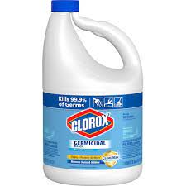
Water-well disinfection
Prior to taking any samples
All wells and distribution systems that are not operated continuously should be disinfected to neutralize any contamination that might have been introduced into them by equipment, material, surface drainage, construction or repair. The following steps must be taken for each water system and completed at least 15 days prior to the property’s occupancy:
Well Disinfection
  1. Prepare a strong chlorine solution by using 2 quarts of an NSF approved unscented hypochlorite or bleach in 5 gallons of safe water. Pour this directly into the well. These doses may vary according to well depth and are good for wells up to 150 feet.
  2. Draw water until a strong chlorine odor is present at a tap at the beginning of the distribution system. Allow the well to sit idle for at least 24 hours. Do not use the water during this time.
  3. After 24 hours let the well pump to waste, preferably through an outside tap being careful not to allow the water to flow on shrubbery or flowers. This should be done until the chlorine odor is no longer apparent at the tap.

Slide 6
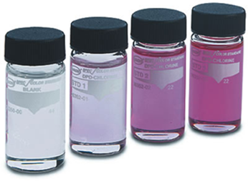
Water-distribution disinfecting
Distribution Disinfection
(1) All water mains shall be disinfected by filling the main to remove all air pockets, flushing the main to remove particulates, and filling the main with potable water. The potable water shall then be chlorinated by feeding liquid hypochlorite at a constant rate such that the water will not have less than a 25 mg/l free chlorine residual (25 ppm) throughout the water system. After a 24-hour holding period there must be a free chlorine residual of not less than 10 mg/l throughout the children’s camp water system.
(2) All water mains shall be flushed, and free chlorine residual disinfection concentrations shall be measured for the two days immediately following the completion of the main disinfection at representative points in the distribution system to ensure chlorine residuals of not less than 0.2 mg/l.
(3) A Total Coliform sample shall be collected from each water source at a representative point in the distribution system following the two-day flushing and chlorine monitoring period and when a free chlorine residual of not more than 2.0 mg/l is present. Pre-operational water analysis reports must be submitted to the permit-issuing official prior to permit issuance.

Slide 7


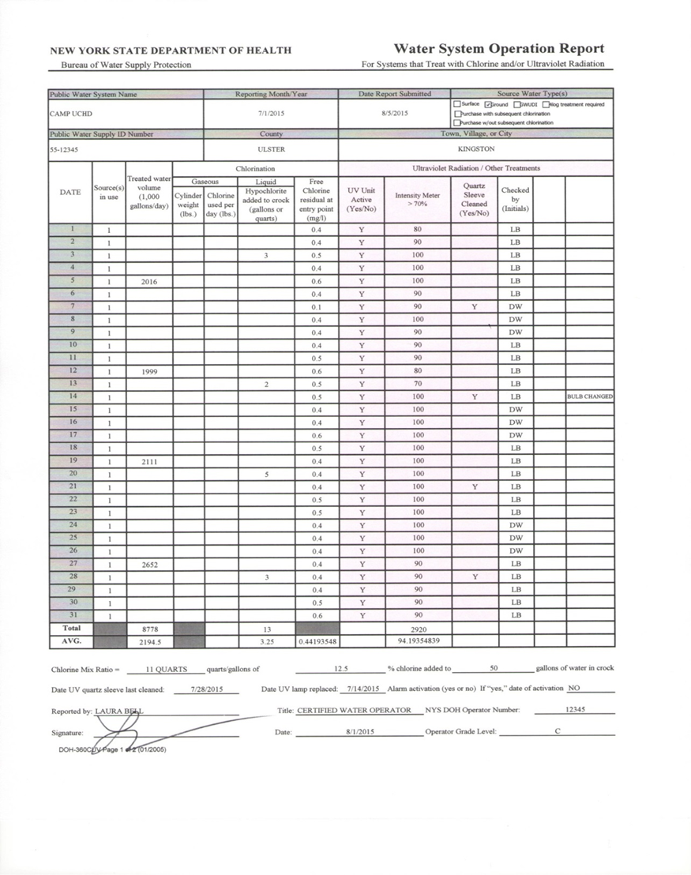
Water-Example Operation Sheet
Bacteriological Samples are to be collected each month that camp operates, even if it is only for a portion of the month. Pre-op samples can count towards the routine sample for the month that they were collected in.
Make sure to submit your Monthly Operation Report by the 10th of the following month.
Operation sheet are now to be submitted to Paige Sheeley DOHNCS@co.ulster.ny.us
A Chlorine residual is to be maintained throughout the distribution system at a minimum of 0.2 ppm and a max of 4.0
Make sure to note any changes.
Make sure to sign and fill out the header and footer the best you can.
*Reminder* Start up procedure, pre-op sample and nitrate sample results are to be submitted before the permit can be issued!

Slide 8

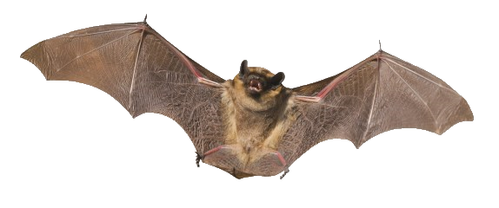

Rabies 2022
Rabies is a fatal but preventable viral disease.
Rabies virus is transmitted through direct contact (such as through broken skin or mucous membranes in the eyes, nose, or mouth) with saliva or brain/nervous system tissue from an infected animal.
People usually get rabies from the bite of a rabid animal.
Animal Tested
102
Number of Positive Results
3
2 Foxes and 1 Skunk Tested Positive
Number of Individuals Who Received Post Exposure Treatment
69
According to the Centers for Disease Control and Prevention (CDC) there
were 5 deaths due to rabies in 2021, all from bat exposures.

Slide 9
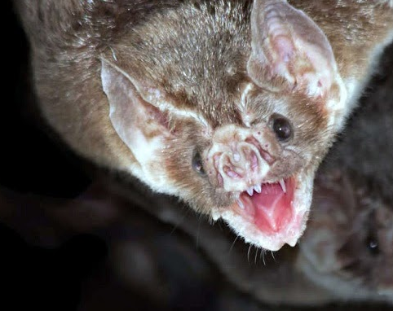
Rabies- Bats
If ANY exposure to a bat occurs, or if a bat is found in a room where someone was sleeping, or someone was present who could not communicate (e.g. infant, young child, person with sensory or mental impairment):
Notify your local health department and describe the circumstances.
Try to confine or capture the bat (without causing damage to the head) www.health.state.ny.us/diseases/communicable/zoonoses/rabies.
To aid in the capturing bats, camps, especially overnight camps, should prepare by having a bat capture kit consisting of:
Gloves (heavy, preferably pliable thick leather)
Forceps (9" to 12" length, rat-tooth for gripping)
Extension pole w/net (fine mesh insect net of polyester or muslin material with a spring steel hoop on telescoping pole – net and pole sold separately)
Coffee can w/tight-fitting lid or similar container (e.g., cardboard ice cream carton w/lid; keep multiple containers on hand)
Sheet of cardboard to slide between wall and container to act as a lid
Tape (to secure lid on container)
Flashlights (including fresh batteries & extra batteries)
General Guidelines for Management of Bat-Related Incidents at Children's Camps
If you are not able to capture and submitted the bat to the UCDOH for testing, you may meet the criteria for post exposure treatment.
This Photo by Unknown Author is licensed under CC BY-SA

Slide 10

National Sex Offender Legislation
New 2023!
In June 2022, the Governor signed legislation amending Public Health Law and General Business Law to require children’s camp operators to ascertain whether an employee or volunteer is listed on the National Sex Offender Registry using the National Crime Information Center. This is to be done prior to the day such employee or volunteer commences work at such camp and annually thereafter prior to their arrival at such camp. However, because the National Crime Information Center database cannot be accessed by camp operators, the Department will accept checking staff against the of the United States Department of Justice National Sex Offender Public Website (nsopw.gov), which is available to the public. Camp operators are directed to enter the individual’s first and last name in the “Search by Name” field, then click on “Name Search”. After agreeing to the conditions of use and entering the captcha, you will see the results of your search. The results will indicate that a national search including all states, territories, and Indian Country was performed.
This means you will need to print out a result from the NSOPW website for each staff member! This can be done by clicking on “Print View” when the results of the search are displayed.
A search may identify records of individuals who share a name with the employee/volunteer. It is the camp operator’s responsibility to review any records generated and verify that the employee/volunteer is not any of the individuals identified by the search.
This will be reviewed at the time of inspection and does not take place of the NYS Sex Offender Registry Search Procedures for Children's Camps!!!!

Slide 11
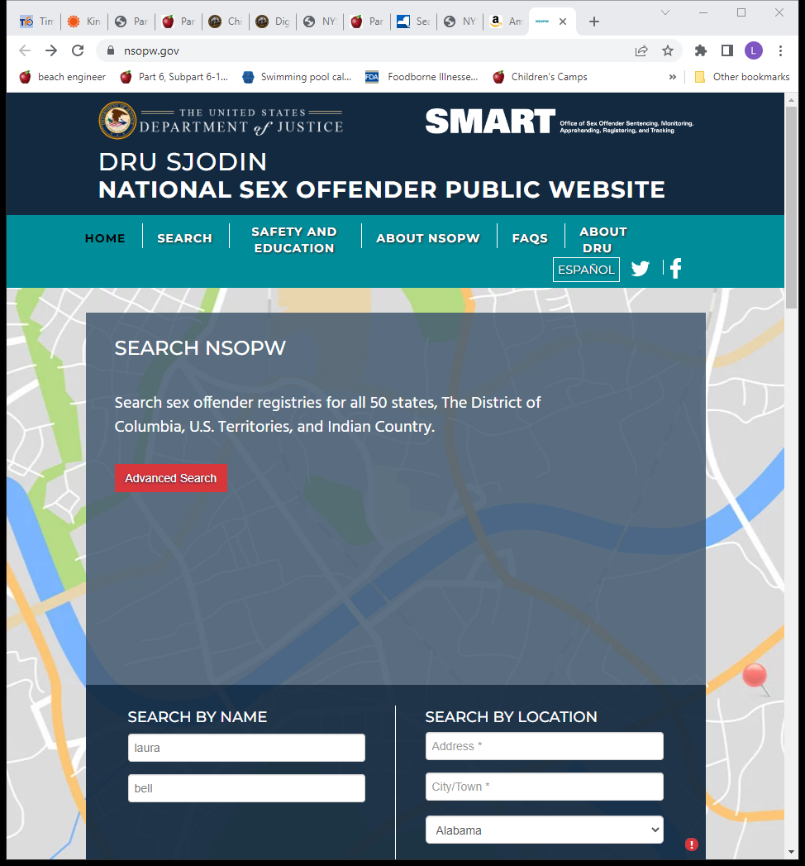
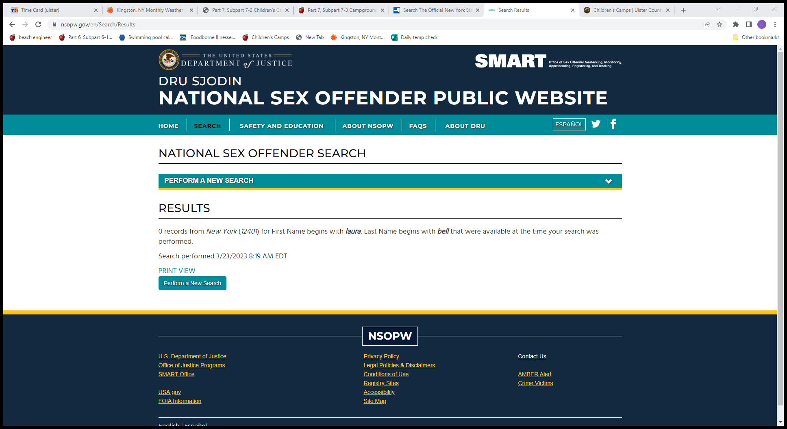
National Sex Offender Legislation
Print out results for all staff members!
If there are multiple pages of records, printing the first page and making a notation that all records were reviewed is considered adequate documentation.

Slide 12

Vaccine Preventable Disease
Since 2019, Ulster County has required all campers to be fully immunized against diphtheria, haemophilus influenza type b, hepatitis b, measles, mumps, poliomyelitis, rubella, tetanus and varicella (chicken pox)
Doses are: 2 MMR; 1 Tdap; 2 Varicella; 3 doses of Hepatitis B and Polio 4 doses: 2 months, 4 months, 6-18 months, 4-6 years.
We do not accept religious exceptions to vaccinations, only valid medical exemptions with documentation.
We also require all staff to be fully immunized against measles and strongly recommend staff have a full immunization for vaccine preventable diseases.
Proof of measles immunization can be:
  Written documentation that two doses was administered from a healthcare provider
  Laboratory evidence of immunity
  Laboratory conformation of measles
  Birth before 1957 in the US
  Valid medical exemption from a healthcare provider
  *This must be available for review at the time of inspection, and will be cited if it is not complete*

Slide 13
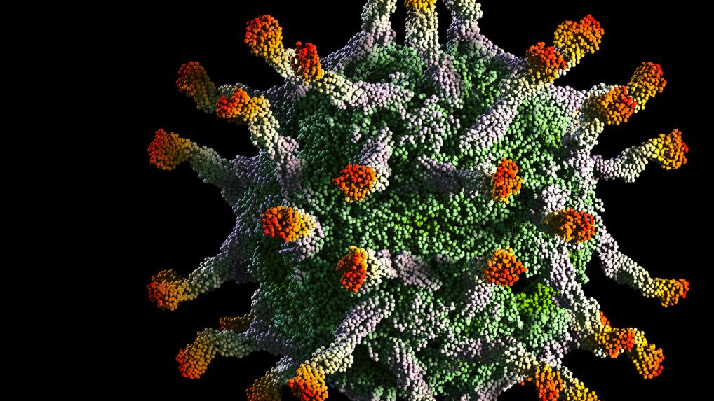
Polio
The first case of Paralytic Polio discovered in New York since its eradication in 1979 was in an unvaccinated individual in Rockland County last summer.
Due to about 75% of Polio cases having no symptoms, it is often a referred to as a “silent spreader”.
Polio has been spreading silently in New York communities for months. After the Rockland County patient developed paralysis, health officials in New York started using wastewater surveillance developed during Covid to test sewage samples.
Ulster County currently has 2 wastewater surveillance sites.
As of January 24, 2023, sequencing analysis by the Centers for Disease Control and Prevention (CDC) confirmed the presence of poliovirus in a total of 100 positive samples of concern:
  Of the 100 positive samples of concern, 93 samples have been found to be genetically linked to the individual case of paralytic polio among a Rockland County resident.
    Of the 93 samples, 44 samples were collected in Rockland County, 30 samples were collected in Orange County, 13 samples were collected in Sullivan County, 5 samples were collected in New York City, all of which were from Brooklyn (Kings County), with 4 of these in an area that contains an adjacent portion in Queens County, and 1 sample was collected in Nassau County.
An additional case of paralytic polio was just identified in Israel last month, which is the same strain as our Rockland County case.
  3 additional contacts have also tested positive, but are all asymptomatic.
This Photo by Unknown Author is licensed under CC BY-ND

Slide 14

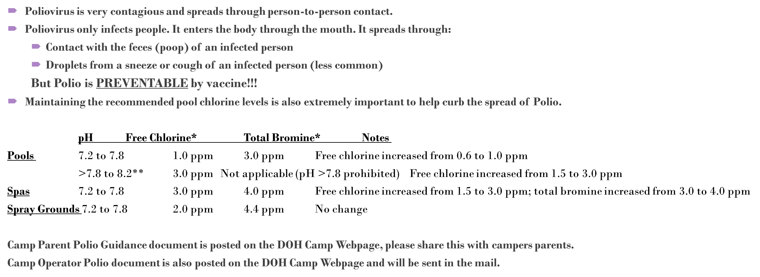
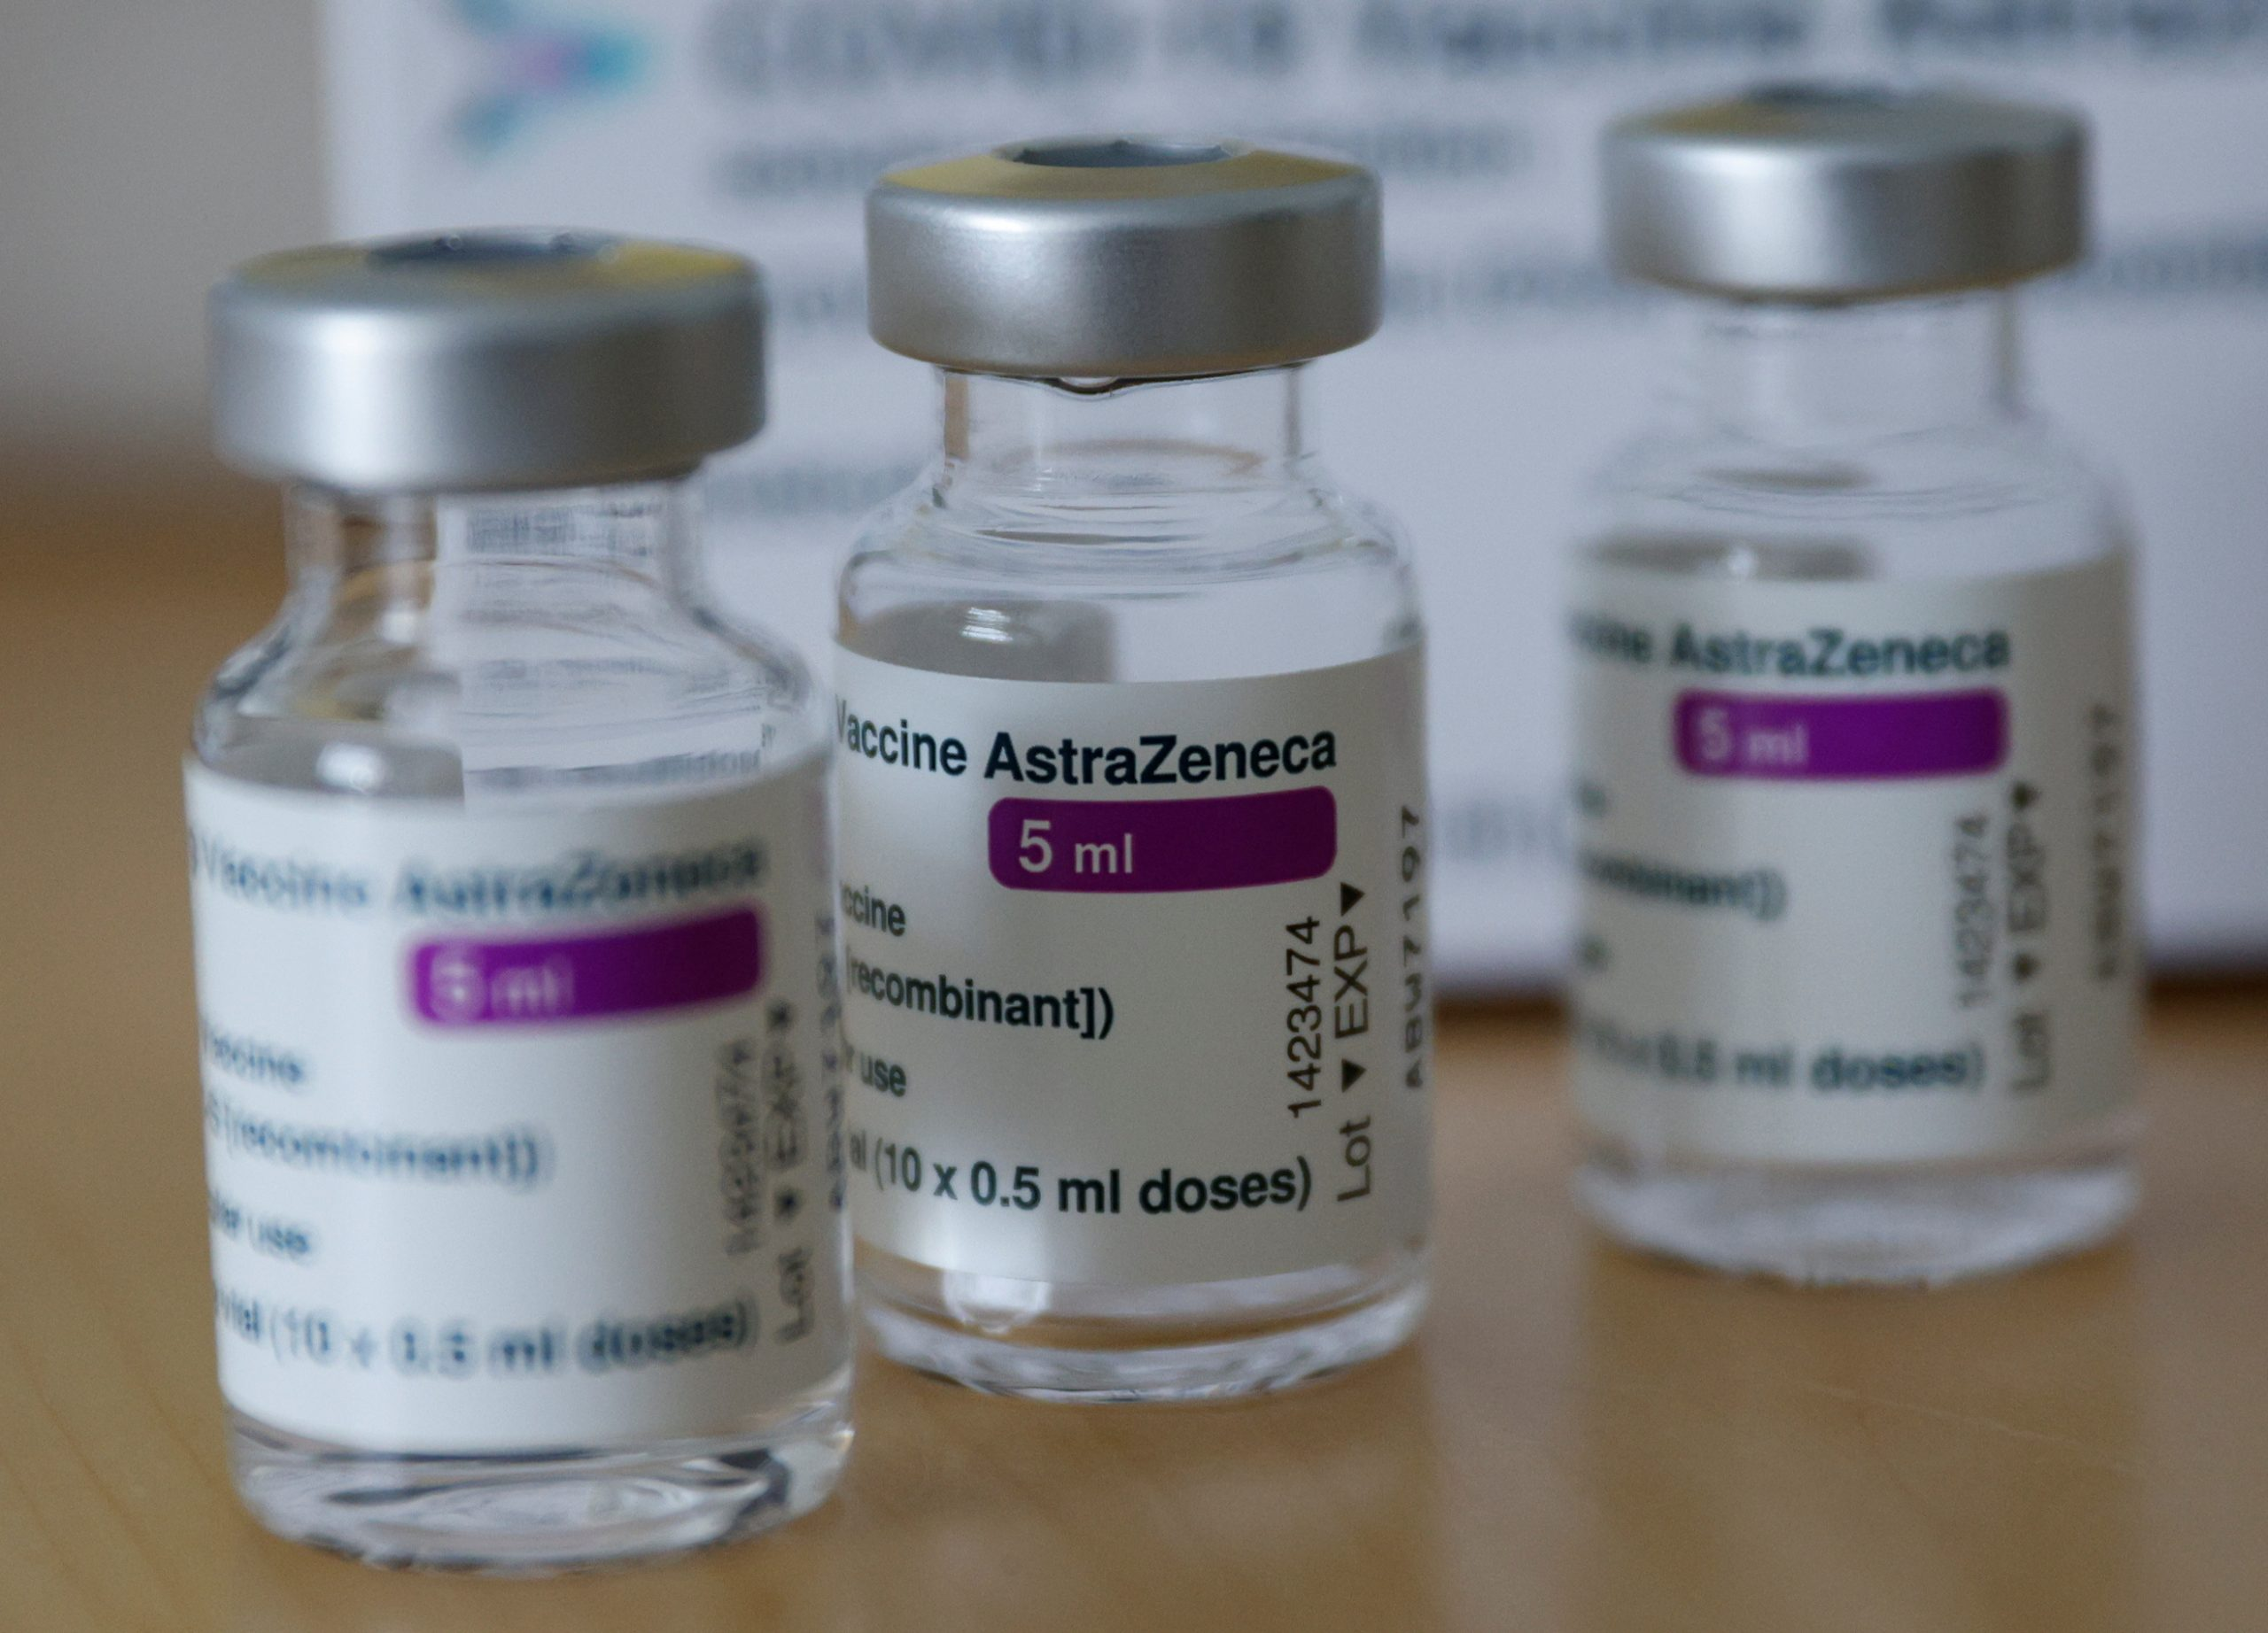
Polio

Slide 15
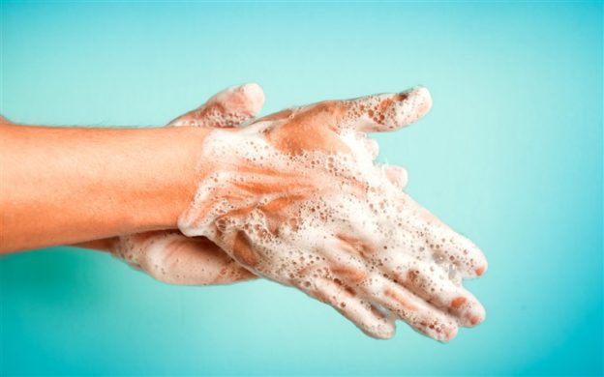
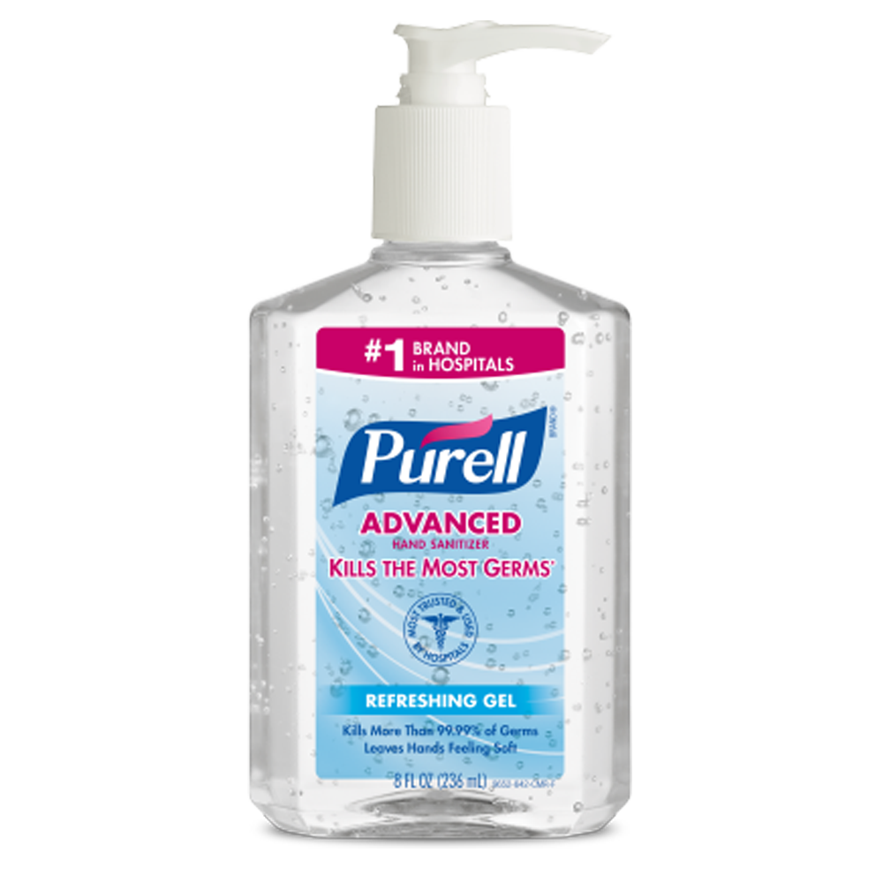
COVID Best Practices
Refer to the UCDOH Camp webpage prior to starting your camp season for COVID or other prevalent disease guidance documents.
If required, camp operators must comply with all masking requirements mandated by New York State (NYS) or Ulster County.
Although The Biden Administration announced its intent to end the COVID national emergency and public health emergency declarations on May 11, 2023, COVID is still currently spreading.
as always, encourage hygiene (e.g., handwashing, cover cough and sneezes, avoid touching eyes, nose, and mouth), and increase cleaning and disinfection practices.

Slide 16
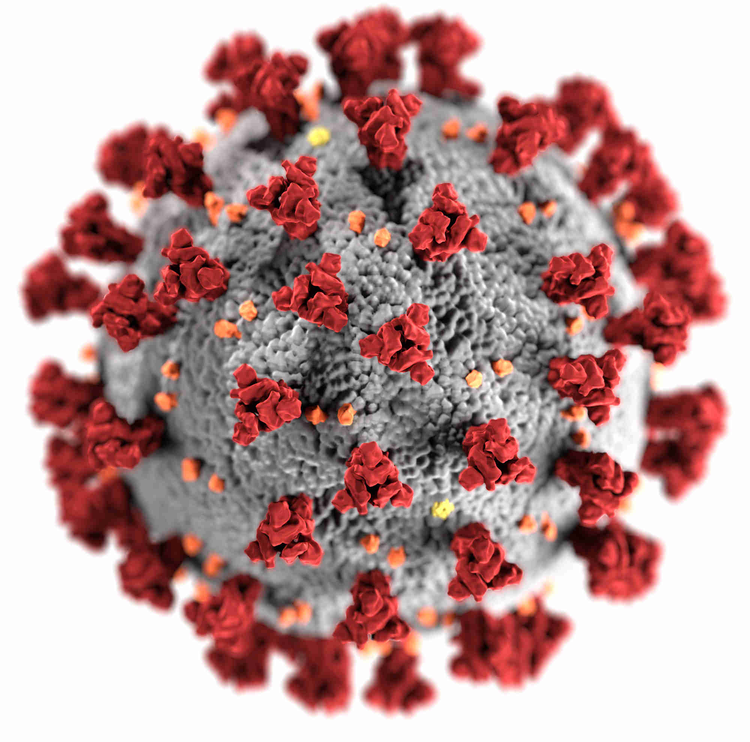
COVID Vaccination
All individuals 6 months of age and older are eligible to receive the COVID vaccine.
CDC recommends that people ages 5 years and older receive one updated (bivalent) booster if it has been at least 2 months since their last COVID-19 vaccine dose, whether that was:
Their final primary series dose, or
An original (monovalent) booster
People who have received more than one original (monovalent) booster are also recommended to get an updated (bivalent) booster. The updated (bivalent) boosters protect against both the original virus that causes COVID-19 and the Omicron variants.
If you have not received the above, you are not considered fully vaccinated.

Slide 17

Meningitis
Meningococcal disease is a rare, but very serious illness caused by a type of bacteria called Neisseria meningitidis. Even if treated quickly, meningococcal disease can cause long-term problems or be deadly.
When someone has meningococcal meningitis, the tissue covering the brain and spinal cord becomes infected and swells. Symptoms of meningococcal meningitis include sudden onset of fever, headache, and stiff neck.
Getting vaccinated is the best way to prevent meningococcal disease.

Slide 18
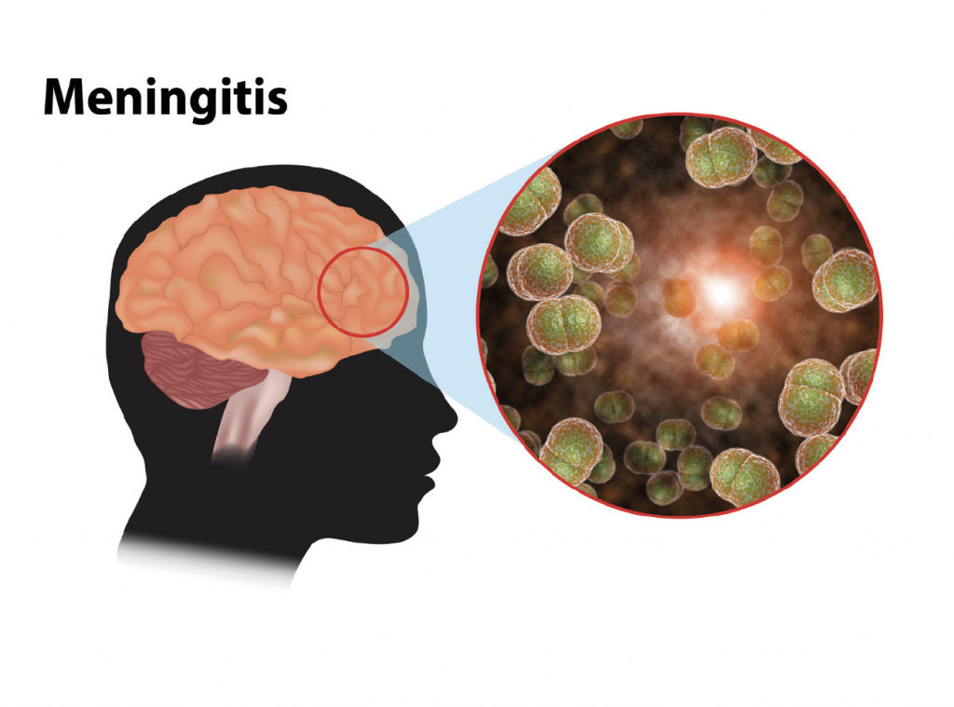
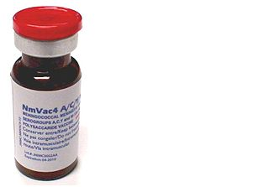
Meningococcal Vaccination
Meningococcal ACWY (MenACWY) vaccine is recommended at age 11 or 12 years, with a booster dose at age 16 years. In New York State, meningococcal vaccination at the recommended ages is required for school attendance. Please note that the NYSDOH does not recommend that campers receive either dose of MenACWY vaccine before the recommended ages. Students who are vaccinated before the recommended ages may need to have the doses repeated in order to attend school.
An overnight camp must provide parents/guardians of campers attending camp for seven(7) or more consecutive nights with written information about meningococcal meningitis and with a copy of an immunization response form that has been approved by the State Commissioner of Health.

Slide 19
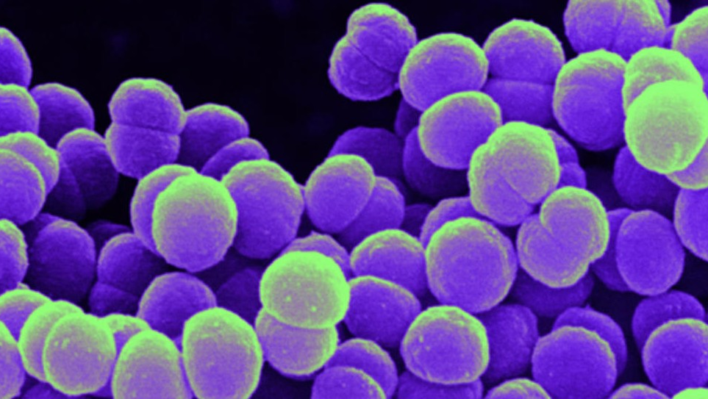
Meningococcal Immunization Parent Letter and Response Form
The written information must include:
(a) a description of meningococcal meningitis and means of transmission;
(b) the benefits, risks and effectiveness of immunization;
and
(c) the availability and estimated cost of immunization, including an indication of whether or not the camp offers meningococcal meningitis immunization services.
The immunization response form must be submitted annually, kept on file at camp, document that the parent/ guardian has received and reviewed the meningococcal meningitis information and certifies that either:
the camper has been immunized against meningococcal meningitis within the past ten years, or
the parent or guardian understands the risk of meningococcal meningitis and the benefits of immunization, and has decided that the camper will not obtain immunization against meningococcal meningitis.
Meningococcal Parent Letter and the Meningococcal Response Form can be found on the UCDOH Webpage!
This Photo by Unknown Author is licensed under CC BY-SA-NC

Slide 20

What type of Injury/Illness must be reported with in 24 Hours?
  Camper and staff injuries or illnesses which result in death or require resuscitation, admission to a hospital or the administration of epinephrine.
  Camper or staff exposures to animals potentially infected with rabies.
  Camper injuries to the eye, head, neck or spine which require referral to a hospital or other facility for medical treatment.
  Injuries where the camper sustains second- or third-degree burns to 5 percent or more of the body.
  Camper injuries that involve bone fractures or dislocations.
  Lacerations sustained by a camper which require sutures, staples or medical glue.
  Camper physical or sexual abuse allegations.
  Camper and staff illnesses suspected of being water-, food- or air-borne or spread by contact.
  See salmon required reporting form in your application packet.
  Report forms for all the above are posted on the UCDOH webpage.

Slide 21
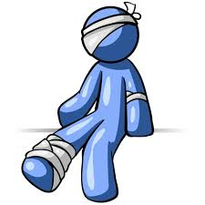
2022 Recap
No Fatalities!!
No Drowning or Near Drowning!!
Outbreaks (2 or more cases of a similar illness associated with a common exposure)
  3 Influenza A with 18-31 cases.
  1 Ill Food Worker with Hepatitis A.
COVID
  About 3,600 Cases were Reported.

Slide 22
Mandated Reporting
New York State recognizes that certain professionals are specially equipped to fulfill the important role of mandated reporter of child abuse or maltreatment. Mandated reporters are required to report suspected child abuse or maltreatment when, in their professional capacity, they are presented with reasonable cause to suspect child abuse or maltreatment.
Director of a children's overnight camp, summer day camp, or traveling summer day camp are mandated reporters.
Mandated reporters can participate in a 2-hour web-based online training course at any time, 24/7, provided by the Office of Children and Family Services at https://www.nysmandatedreporter.org/TrainingCourses.aspx
Allegation of Abuse Report Form can be found on the UCDOH webpage.

Slide 23
Mandated Reporting
• The Ulster County Family and Child Advocacy Center (FCAC), located at 51 Hurley Avenue, in Kingston, also provides a free 40-minute training for Children’s Day and Overnight Camp Staff.
• The training, Less is More, meets the New York State DOH requirement for training in Child Abuse Recognition and Prevention (DOH Subpart 7-2)
• Training objectives include:
o What is needed to make a call to the State Central Registry (SCR)
o How to gather the necessary information without questioning the child
o Importance of the role of a Mandated Reporter
o What a CAC is and how it works
o Why some cases do not move forward
To request more information or to schedule a training, please call the FCAC at (845) 334-5155 or contact Mary Trish Cina, Assistant Director of Services at maci@co.ulster.ny.us

Slide 24

Trip Swimming and Aquatics Director
If your camp plans on swimming, even for a 1-day field trip, you are required to have an approved Camp Trip Swimming safety plan appendix on file and a certified Aquatics Director.
A camp Aquatics Director must oversee all swimming activities that occur at swimming pools and bathing beaches operated as part of a children’s camp.
  When swimming is onsite, this person shall supervise lifeguards and other required staff during swimming activities and implement the camp safety plan and oversee all aspects of the buddy check.
  When swimming is offsite, they must implement the camp safety plan and oversee all aspects of the buddy check.
Although the Lifeguard Management class is only being offered online, certifications must be accompanied by a separate certification or statement from the instructor indicating an in-person testing session.

Slide 25


Aquatics Director
The camp aquatics director must:
  be at least 21 years of age and have a minimum of:
  one season of previous experience as a camp aquatics director at a New York State children’s camp; or
  two seasons of previous experience consisting of at least 12 weeks as a children’s camp lifeguard which had more than one lifeguard supervising it at a time; or
  18 weeks of previous experience as a lifeguard at a swimming pool or bathing beach, which had more than one lifeguard supervising it at a time.
Hold an accepted and current cardiopulmonary resuscitation (CPR) certificate as listed on the Fact Sheet.
Annually review and document the review of the camp’s safety plan for swimming.
Example: I_______________, the aquatics director for camp ___________, have reviewed the camp safety plan and will operate the aquatics program accordingly.
Date ____________

Slide 26


Aquatics Director
WSI or a PSI is not an Aquatics Director, the Aquatics Director must have the Lifeguard Supervision and Management or Lifeguard Instructor certification, but an Aquatics Director may ALSO be your WSI and Lifeguard if certified to do so.
An Aquatics Director may not:
perform lifeguard duties unless currently certified as a qualified lifeguard
or
assess swimming ability unless currently certified as a progressive swimming instructor or WSI.
The lifeguard must always be on the pool deck and not in the pool with campers unless an additional lifeguard is on deck.

Slide 27



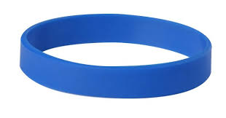
Buddy Check
Failure to implement a complete buddy system has been a significant contributing factor in every camper drowning related to a children’s camp since 1986.
A Water Safety Instructor (WSI) assesses the swim ability of all campers.
Campers are broken down into buddy pairs with similar swim abilities and given buddy numbers.
Campers swim level is to be easily identified. Ex; using a colored wrist band or bathing cap.
If there is an odd number of campers one triple pair is allowed for each swim level.
If a swimmer is paired with a non-swimmer both bathers must stay in water less than chest deep or in the non-swimmer section.
If the shallowest part of the pool is still greater then chest deep on non-swimmers an approved alternate procedure must be addressed in the camp safety plan.
A buddy check is to be conducted every 15 minutes or less.

Slide 28
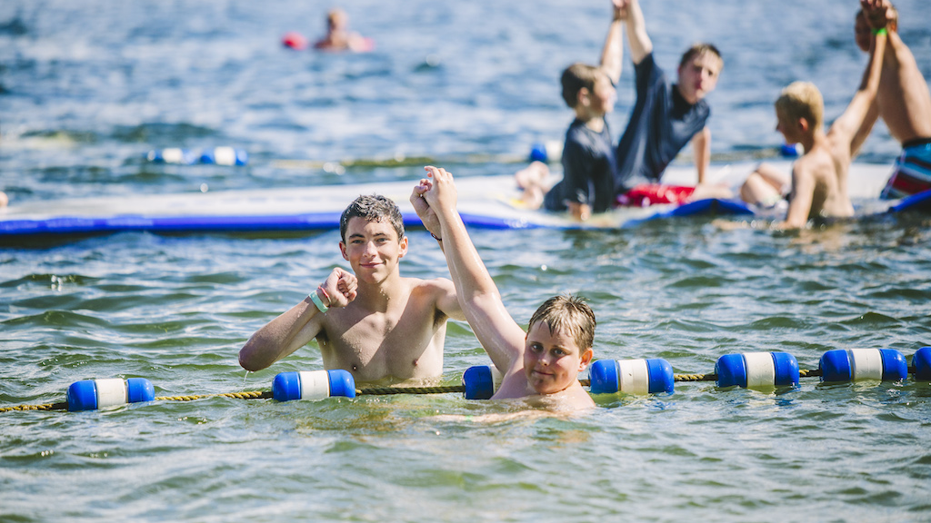

Buddy Check
Having a buddy pair when one camper is in the water and one camper is on the deck is not an adequate buddy pair and the camp will be cited a violation. This was a common violation cited in 2022.
Reminder that campers at an OPWDD camp need a signed permission slip for all swimming.
Also, all camps, when swimming is conducted during camp trips including aquatic amusement park activities, each camper shall have a signed statement of permission to participate from a parent/guardian.
Example buddy clip board sheets can be found on the camp web page, feel free to print and use these.
Swimming is the most dangerous activity done at a camp and an appropriately orchestrated buddy system could save a life.

Slide 29
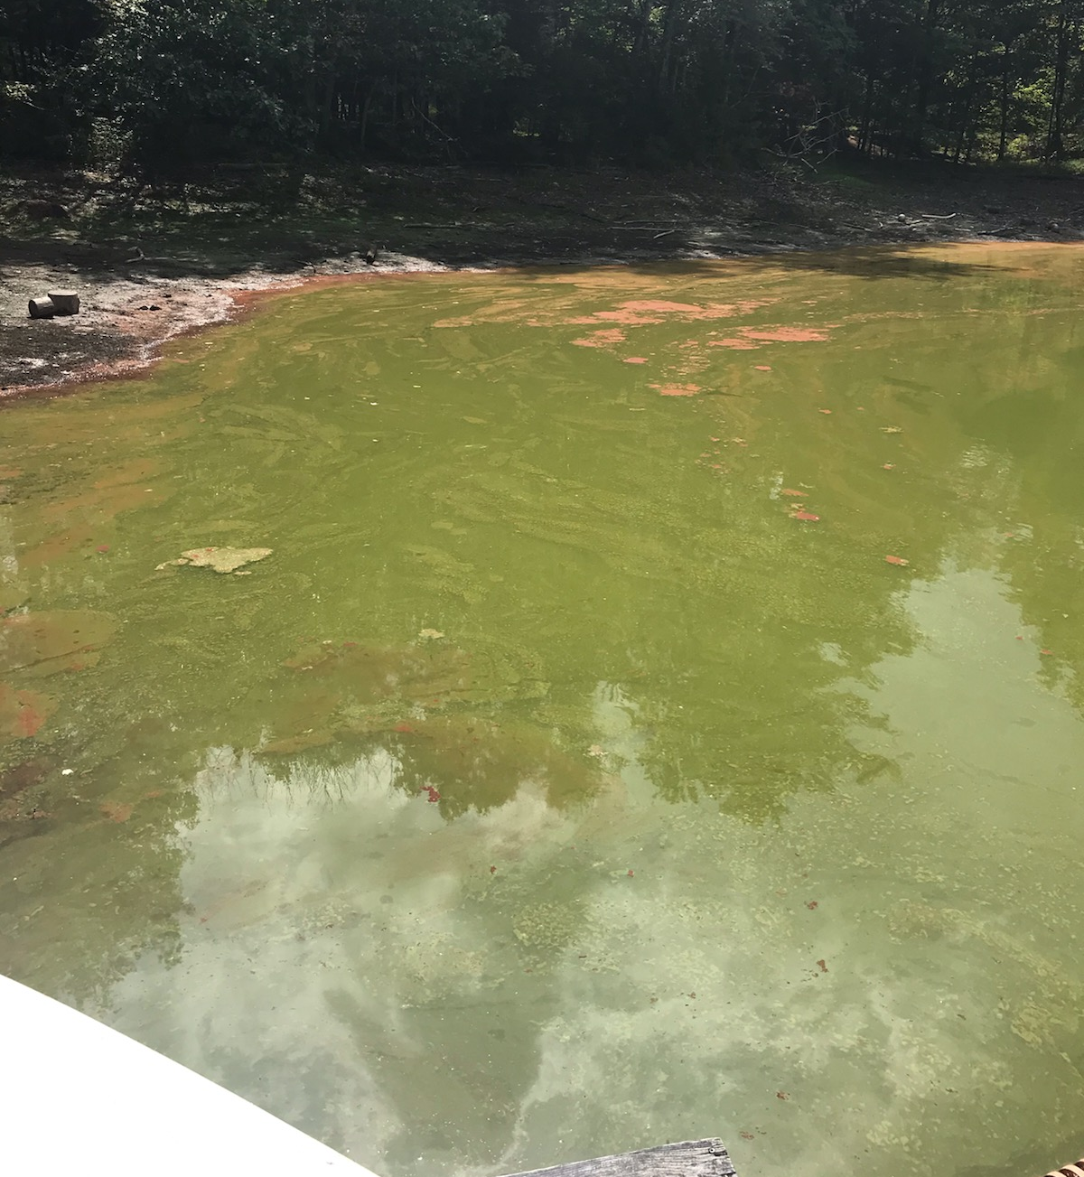
Harmful Algal Bloom
Be sure to monitor your natural recreational water for an signs of a harmful algal bloom.
HABs can cause illness in humans and animals.
If you notice any signs of a HAB, discontinue all related recreational water uses and contact the UCDOH.
There were 10 HAB beach closures in 2022
7 were at children’s camps

Slide 30
Supervision Ratio Reminder
Passive Activity - 1:25
Day Camp - 1:12
Overnight Camp - 8 years of age and older 1:10, less than 8 years of age 1:8, 20% of counselors can be 17.
Rest Area - 1 counselor per sleeping area.
Archery - 1:10
Boating - 1:8 for campers 6 years of age and older and 1:6 for campers younger than 6 years of age. Boats with 8 or more campers carrying non-swimmers need a lifeguard in boat.
Horseback Riding - 1:8 for campers 6 years of age and older and 1:6 for campers younger than 6 years of age.
Transportation - 1:12
Lifeguard - 1:25
Aquatic Activities - 8 years of age and older 1:10, 6 and 7 years of age 1:8, under 6 years old 1:6. Your lifeguard does not count as a counselor!
Wilderness swimming - 1:8 for campers 6 years of age and older and 1:6 for campers younger than 6 years of age.
Camp Trip Activities Including Swimming -1:8 for campers 6 years of age and older and 1:6 for campers younger than 6 years of age.
Non-ambulatory camper - 1:2
Non-ambulatory or uncontrolled epilepsy - 1:1 for aquatic activity.
Developmentally disabled campers aquatic ratio other than described above - 1:5

Slide 31

Please make sure you fill in your email address on your camp application. Everything is digital, so without an email address linked to your facility, it is difficult to receive your inspection reports.
As always, permits will not be issued until we have received all application paperwork and staff certifications.
Please email Brianna once you have reviewed this training in its entirety.
bhaf@co.ulster.ny.us

